Slide 1

Wireless Networking
Ambuj Varshney
ambujv@nus.edu.sg

Slide 2
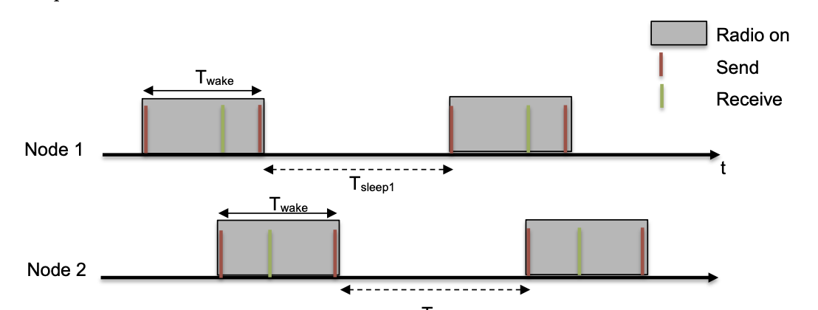
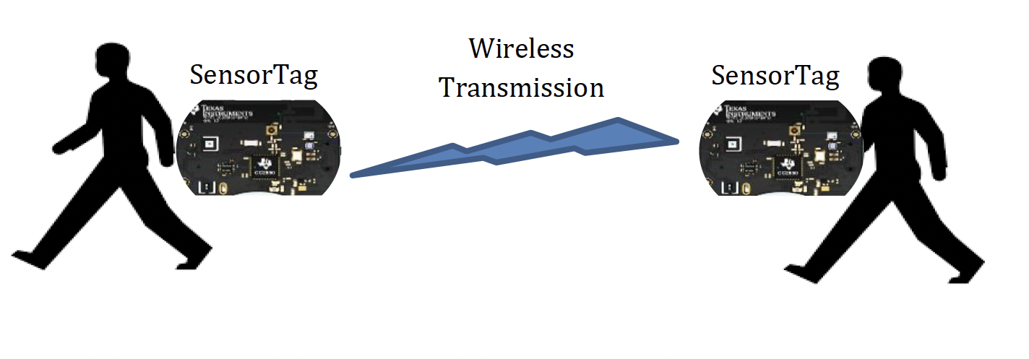
Discussion regarding the project
Deadline: April 26th April
Submission after deadline: No Penalty (Last date: 30th April)
Two tasks needs to be performed. Builds on previous assignments
To be submitted: Report, source code, demonstration, readme file

Slide 3
Final Assessment
April 29th. Open Book.
Will be held using ExamSoft system. More details next week.
I will send an email explaining the logisitics for exam
What is the best way to prepare for final assessment?
Practice questions and concepts covering questions in the tutorials.

Slide 4
Roadmap of the lecture today
General course information and updates
Let us review what we had covered the last lecture
Wi-Fi
Cellular
Bluetooth

Slide 5
What do you mean by routing?
You know destination, have a packet, how do you send this packet towards the destination node ? This is the routing question.
Routing is trivial if all nodes are connected to each other
Problem: if N nodes, need N(N-1) or O(N²) (uni-directional) links
Simple techniques: broadcast, tree structures
Mesh techniques: understand available routes and select a “good” one

Slide 6
Performing routing in the wireless networks
Routing protocols are complex, hard to maintain/debug and incurred significant overhead. More so for wireless networks.
In practice, wireless network deployments are single-hop and routing is trivial. All stations/devices communicating directly with base stations
Example: WiFi, Cellular Network, LoRa
Can one-hop communication be always sufficient by using sufficiently long range radio and large number of base stations?
Why multi-hop routing?
Better in terms of reach/coverage for the same number of base stations
Provides more routes, potentially more robust

Slide 7
Mesh Routing
Formed by a network of static wireless nodes
Mesh topology makes routing question more complicated
Multiple hops in a route
Multiple routes between source and destination
Becomes a graph theory question based on cost metric
B
C
A
D
F
E

Slide 8
What is the mesh equivalent of broadcast?
Flooding is the mesh equivalent of broadcast (communicate to all)
Each node sends information to every other node in the mesh
Eventually the packets will reach the desired destination
Goal: get information to all nodes
This is the problem of “data dissemination”
Problem: difficult in Mesh topologies
Packet loss, retransmission delays
Question: How do we make flooding stop?
Question: Is it really routing?

Slide 9
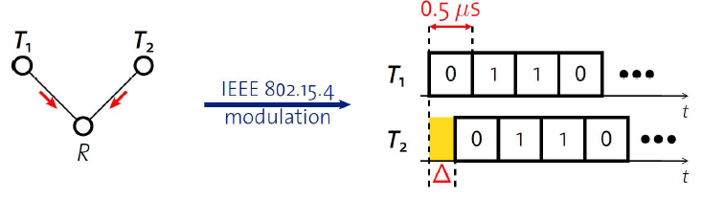
Synchronous transmissions
Multiple nodes transmit same packet at same time
R can receive packet with high probability if Δ is small
May even improve probability of reception (more energy at receiver)
500 ns is 1/32 of a symbol for 802.15.4 (chip duration)

Slide 10
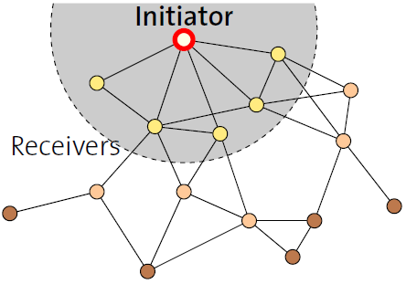
Fast packet propagation in Glossy

Slide 11
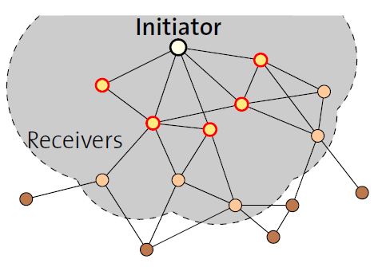
Fast packet propagation in Glossy

Slide 12
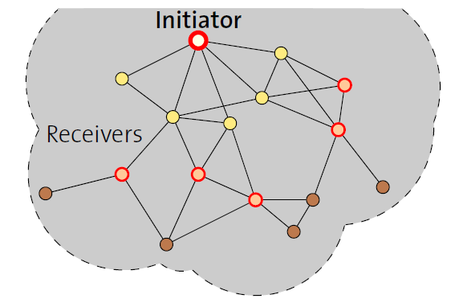
Fast packet propagation in Glossy

Slide 13
Routing in wireless mesh and routing metrics
What are some possible metric to make routing decisions?
Hop Count
Delay
Reliability
Energy
Other?

Slide 14
Reliability as a cost metric
Link quality can very from node to node
Fewest hops might not be the “fastest” or “most reliable” path
ETX: minimize “expected transmissions”
Measure link quality over time to determine each link’s reliability
B
C
A
D
F
E

Slide 15
Classification of the routing protocols
The existing routing protocols can be classified as:
Proactive: When a packet needs to be forwarded, the route is known
Reactive: Determine a route only when there is data to send

Slide 16
Reactive routing
Build up a map of the routes through a network
Hopefully the “optimal” routes
Map routes in reaction to a packet arrival
Sensor devices are slow and limited
Most likely to resend to same prior address
Discover a route when it is needed, then cache for next time

Slide 17
Tradeoffs for reactive routing
Upside: no transmissions unless there is demand
Routes might appear, disappear, reappear, but no need to update if no one actually wants to transmit anything
Downside: large, variable delay when actually sending a packet
Full RREQ/RREP protocol before data can actually be sent
Route might have broken at some point
So data will be sent based on cached information
RERR will occur
RREQ/RREP will occur
Then data will be sent again

Slide 18
Proactive routing
Alternative to reactive is to know the routes ahead of time
Periodically query for the possible routes in the network
Save all routes that are important (maybe just all routes?)
Also redetermine routes whenever topology changes (nodes join/leave)
Upside: when a packet arrives, route to destination is already known
Downside: requires more memory and effort on part of routers
Wastes some network bandwidth on checking for route changes

Slide 19
Roadmap of the lecture today
General course information and updates
Let us review what we had covered the last lecture
Wi-Fi
Cellular
Bluetooth

Slide 20
Basic facts about WiFi
Most of us know about WiFi! Laptops, mobile phones, other devices?
Covers small area (approx. 10 to 30 meters), Very high speed
The WiFi standard is almost 30 years old!
Notes:
++ While we are deploying an enormously large number of IoT devices, I claim that very little attention is being paid to their energy challenge.
++ Today, most IoT devices are very energy expensive, and consequently, they rely on bulky batteries such as AA/AAA sized batteries for their operation. Even when operating on these batteries, they require frequent replacement of the exhausted batteries. This can be challenging when performed at a massive scale, especially considering that we may have a trillion embedded device deployed in the world.
++ Further, it can also harm the environment. These batteries use toxic chemicals, which means now we can have billions of toxic chemicals laden batteries that would be disposed of in landfills. This is especially important as sustainability has become an essential aspect across the world; in fact, imperial college was celebrating sustainability week.

Slide 21
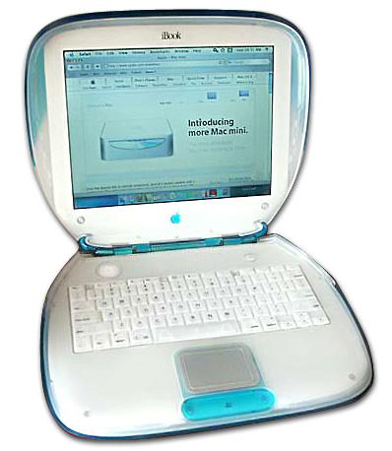
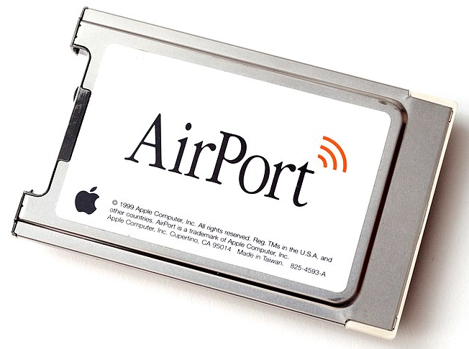
WiFi standard timeline
1985 – US FCC rules ISM band for unlicensed use
1990s – WaveLAN (NCR Corporation, Netherlands)
Wireless ethernet for cashier systems
1997 – 802.11 specification
1999 – 802.11b and 802.11a amendments
1999 – WiFi Alliance formed for certification of devices
1999 – Apple iBook is the first consumer WiFi product
Notes:
++ While we are deploying an enormously large number of IoT devices, I claim that very little attention is being paid to their energy challenge.
++ Today, most IoT devices are very energy expensive, and consequently, they rely on bulky batteries such as AA/AAA sized batteries for their operation. Even when operating on these batteries, they require frequent replacement of the exhausted batteries. This can be challenging when performed at a massive scale, especially considering that we may have a trillion embedded device deployed in the world.
++ Further, it can also harm the environment. These batteries use toxic chemicals, which means now we can have billions of toxic chemicals laden batteries that would be disposed of in landfills. This is especially important as sustainability has become an essential aspect across the world; in fact, imperial college was celebrating sustainability week.

Slide 22
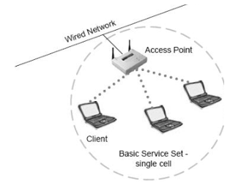
Basic WiFi network
Star topology network
Basic Service Set (BSS)
Access point(s)
Multiple connected clients
Service Set ID (SSID)
Identifies network
Broadcast by access point in beacons

Slide 23
Backoff in WiFi
Listen for activity
If free
Wait for Inter Frame Spacing (IFS)
If still free, transmit
If busy
Randomly select a number of backoff Slots
Count down slots whenever medium is not busy
If busy when backoff completes:
Increase maximum backoff Slots
Repeat
Slot time: basic time unit for protocol
Total time of: switch from Rx to Tx, plus processing time, plus propagation delay

Slide 24
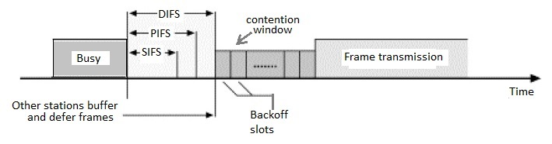
Prioritizing packets with varying IFS
Tiered Contention Multiple Access (TCMA)
Idea: assign different inter-frame spacing based on traffic class
Inherently prioritizes communication
Acknowledgements sent with Short IFS (SIFS)
Will always transmit before new data clears CSMA check
New data sent with DCF IFS (DIFS)

Slide 25
802.11 backoff example
B reaches zero backoff, finds channel empty, transmits
A pauses its backoff again for duration plus ACK
Other Traffic
ACK
C Traffic
ACK
B Traffic
SIFS
DIFS
DIFS
SIFS
DIFS
A
Arrival A
Backoff = 10
Backoff = 6
B
Arrival B
Backoff = 8
Backoff = 4
C
Arrival C

Slide 26
Goal: improve throughput
In twenty years, WiFi has gone from 2 Mbps to 9.6 Gbps
How does a network PHY improve its throughput?
More capable modulation and/or bit transmission
Techniques like OFDM and MIMO
More bandwidth
Increased channel with at 2.4 Ghz and bigger 5 GHz channels

Slide 27
Major amendments
 | Protocol | Year | Frequency | PHY | Max Rate | Range
- | 802.11 | 1997 | 2.4 GHz | DSSS/FHSS | 2 Mbps | 20 m
1 | 802.11b | 1999 | 2.4 GHz | DSSS | 11 Mbps | 35 m
2 | 802.11a | 1999 | 5 GHz | OFDM | 54 Mbps | 35 m
3 | 802.11g | 2003 | 2.4 GHz | OFDM | 54 Mbps | 38 m
4 | 802.11n | 2009 | 2.4/5 GHz | OFDM + MIMO | 600 Mbps | 70 m
5 | 802.11ac | 2013 | 5 GHz | OFDM + MU-MIMO (downlink only) | 3.4 Gbps | 35 m
6 | 802.11ax | 2021 | 2.4/5/6 GHz | OFDMA + MU-MIMO | 9.6 Gbps | 35 m
802.11b was very popular but is now usually unsupported
802.11a never saw major deployment

Slide 28
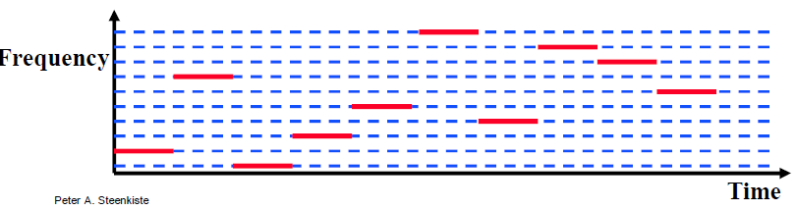
Original WiFi specification (1997)
Legacy WiFi
Frequency Hopping Spread Spectrum (FHSS)
GFSK (Gaussian Frequency-Shift Keying)
Relatively simple radio design
Frequency hopping over 80 channels (1 MHz each)

Slide 29
Major amendments
 | Protocol | Year | Frequency | PHY | Max Rate | Range
- | 802.11 | 1997 | 2.4 GHz | DSSS/FHSS | 2 Mbps | 20 m
1 | 802.11b | 1999 | 2.4 GHz | DSSS | 11 Mbps | 35 m
2 | 802.11a | 1999 | 5 GHz | OFDM | 54 Mbps | 35 m
3 | 802.11g | 2003 | 2.4 GHz | OFDM | 54 Mbps | 38 m
4 | 802.11n | 2009 | 2.4/5 GHz | OFDM + MIMO | 600 Mbps | 70 m
5 | 802.11ac | 2013 | 5 GHz | OFDM + MU-MIMO (downlink only) | 3.4 Gbps | 35 m
6 | 802.11ax | 2021 | 2.4/5/6 GHz | OFDMA + MU-MIMO | 9.6 Gbps | 35 m
802.11b was very popular but is now usually unsupported
802.11a never saw major deployment

Slide 30
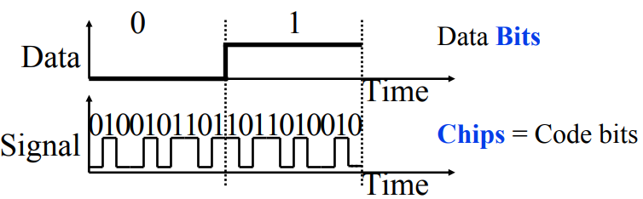
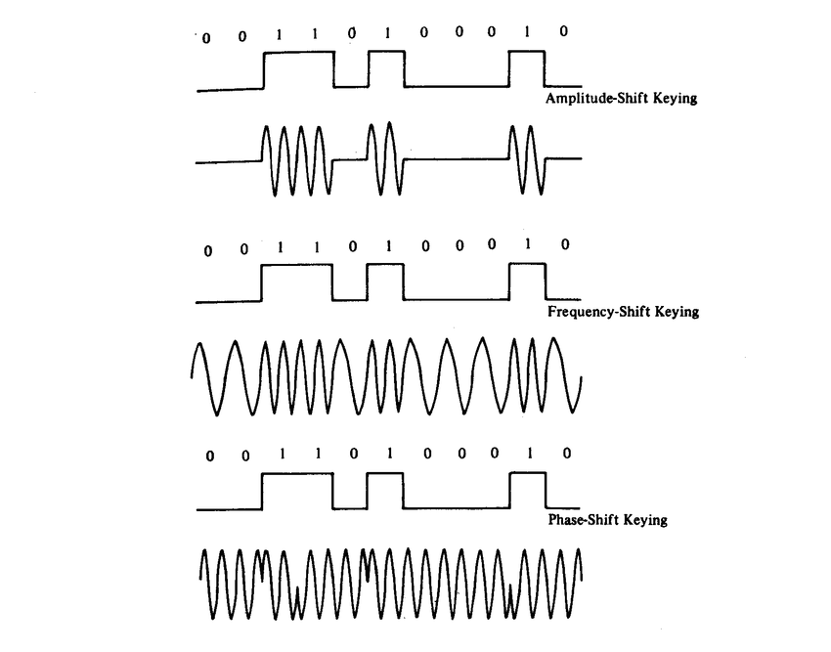
802.11b (1999)
802.11b
Direct Sequence Spread Spectrum (DSSS)
DBPSK and DQPSK (Differential Binary/Quadrature Phase-Shift Keying)
Translate data into “codes”
Each data bit corresponds to several code bits (Chips)
Chips are what is actually modulated over the air
Data can be recovered by knowing the code patterns
Modulation
Phase-shift Keying (of the Chips)

Slide 31
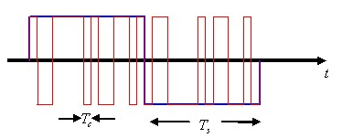
DSSS goals
DSSS increases bandwidth of a signal
Beyond what is needed for the data
Energy is smeared across the frequencies
More robust against interference
Data can be recovered from partial code
Cost: using a lot of bandwidth for only a little data

Slide 32
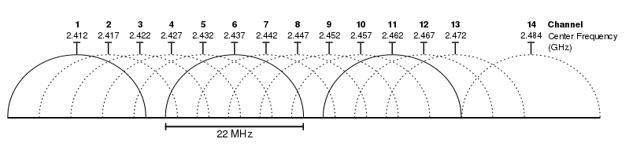
802.11b channels
14 channels total
1-11 for US
1-13 for most of the rest of the world
1-14 for Japan (but 14 only for 802.11b)
22 MHz channels
5 MHz spacing -> significant channel overlap
Channels 1, 6, and 11 can be used without overlap

Slide 33
Major amendments
 | Protocol | Year | Frequency | PHY | Max Rate | Range
- | 802.11 | 1997 | 2.4 GHz | DSSS/FHSS | 2 Mbps | 20 m
1 | 802.11b | 1999 | 2.4 GHz | DSSS | 11 Mbps | 35 m
2 | 802.11a | 1999 | 5 GHz | OFDM | 54 Mbps | 35 m
3 | 802.11g | 2003 | 2.4 GHz | OFDM | 54 Mbps | 38 m
4 | 802.11n | 2009 | 2.4/5 GHz | OFDM + MIMO | 600 Mbps | 70 m
5 | 802.11ac | 2013 | 5 GHz | OFDM + MU-MIMO (downlink only) | 3.4 Gbps | 35 m
6 | 802.11ax | 2021 | 2.4/5/6 GHz | OFDMA + MU-MIMO | 9.6 Gbps | 35 m
802.11b was very popular but is now usually unsupported
802.11a never saw major deployment

Slide 34
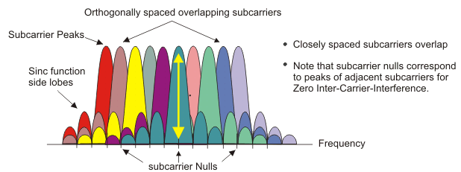
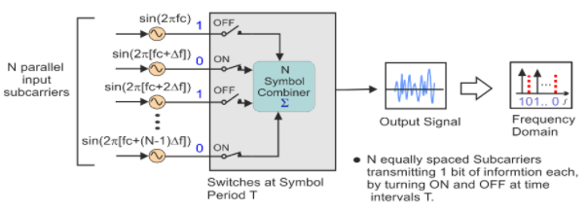
OFDM enables higher throughput
Replace DSSS with Orthogonal Frequency Division Multiplexing
OFDM idea
Split band into a number of narrow subcarriers
Subcarriers are spaced so that they don’t interfere
Transmit on multiple subcarriers at once to increase throughput
Recall DSSS

Slide 35
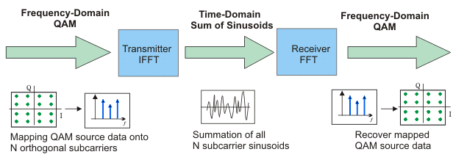
OFDM higher throughput at complexity cost
Receivers collect signal from entire channel
And then can split it apart to gain the data on each subcarrier
Tradeoffs
Benefits: more throughput, still robust against narrowband interference
Costs: more complicated and sensitive radio design

Slide 36
Major amendments
 | Protocol | Year | Frequency | PHY | Max Rate | Range
- | 802.11 | 1997 | 2.4 GHz | DSSS/FHSS | 2 Mbps | 20 m
1 | 802.11b | 1999 | 2.4 GHz | DSSS | 11 Mbps | 35 m
2 | 802.11a | 1999 | 5 GHz | OFDM | 54 Mbps | 35 m
3 | 802.11g | 2003 | 2.4 GHz | OFDM | 54 Mbps | 38 m
4 | 802.11n | 2009 | 2.4/5 GHz | OFDM + MIMO | 600 Mbps | 70 m
5 | 802.11ac | 2013 | 5 GHz | OFDM + MU-MIMO (downlink only) | 3.4 Gbps | 35 m
6 | 802.11ax | 2021 | 2.4/5/6 GHz | OFDMA + MU-MIMO | 9.6 Gbps | 35 m
802.11b was very popular but is now usually unsupported
802.11a never saw major deployment

Slide 37
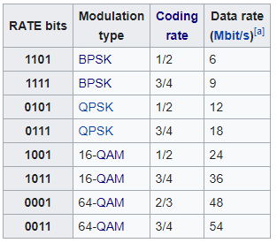
802.11a (1999)
Applied OFDM techniques on the 5 GHz band
Enabled more data throughput 54 Mbps (compare to 11 Mbps for 802.11b)
Multiple rates available
BPSK/QPSK/QAM over OFDM
Quadrature Amplitude Modulation (QAM)
Never reached widespread adoption
Regulatory hurdles in some regions
More complicated hardware delayed it

Slide 38
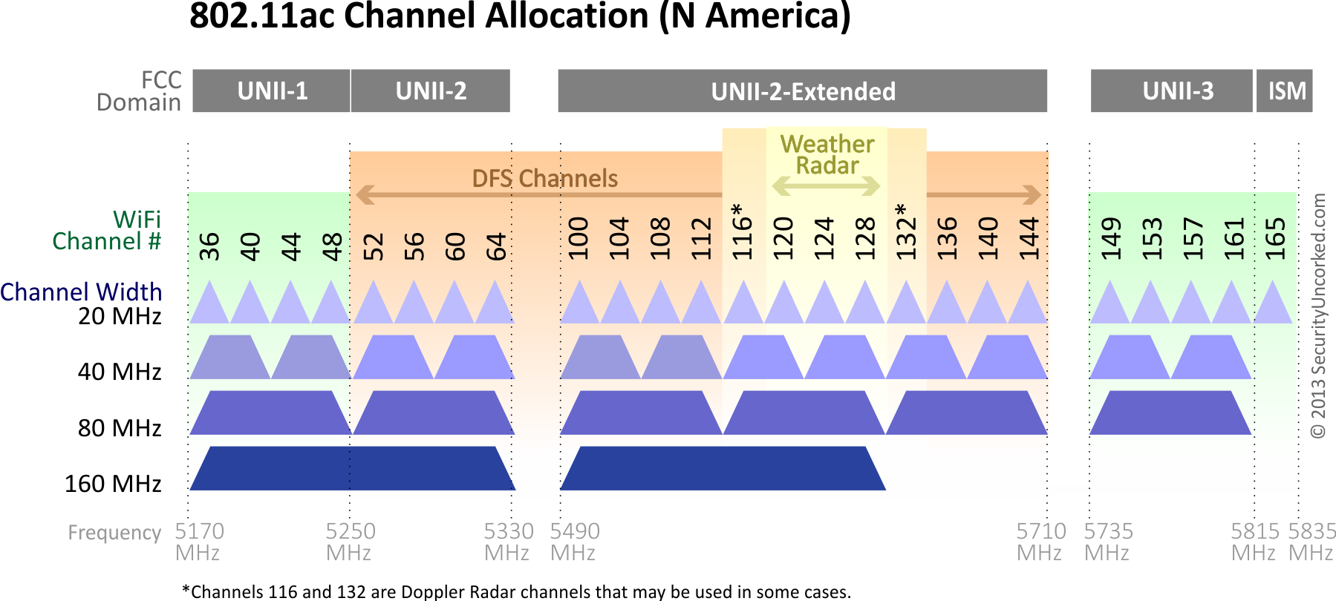
802.11a channels
802.11a did promote the use of 5 GHz band
Several 20 MHz channels with no overlap
Big increase from “three” channels of 2.4 GHz
Various regional rules on a number of different channels
Needs to avoid frequencies in use by existing radar deployments
Orange channels aren’t used, except for enterprise

Slide 39
Major amendments
 | Protocol | Year | Frequency | PHY | Max Rate | Range
- | 802.11 | 1997 | 2.4 GHz | DSSS/FHSS | 2 Mbps | 20 m
1 | 802.11b | 1999 | 2.4 GHz | DSSS | 11 Mbps | 35 m
2 | 802.11a | 1999 | 5 GHz | OFDM | 54 Mbps | 35 m
3 | 802.11g | 2003 | 2.4 GHz | OFDM | 54 Mbps | 38 m
4 | 802.11n | 2009 | 2.4/5 GHz | OFDM + MIMO | 600 Mbps | 70 m
5 | 802.11ac | 2013 | 5 GHz | OFDM + MU-MIMO (downlink only) | 3.4 Gbps | 35 m
6 | 802.11ax | 2021 | 2.4/5/6 GHz | OFDMA + MU-MIMO | 9.6 Gbps | 35 m
802.11b was very popular but is now usually unsupported
802.11a never saw major deployment

Slide 40
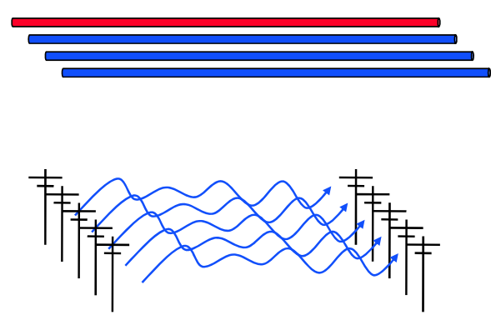
How do we increase throughput?
Wired world
Add more wires in parallel
Wireless world
Add more antennas?

Slide 41
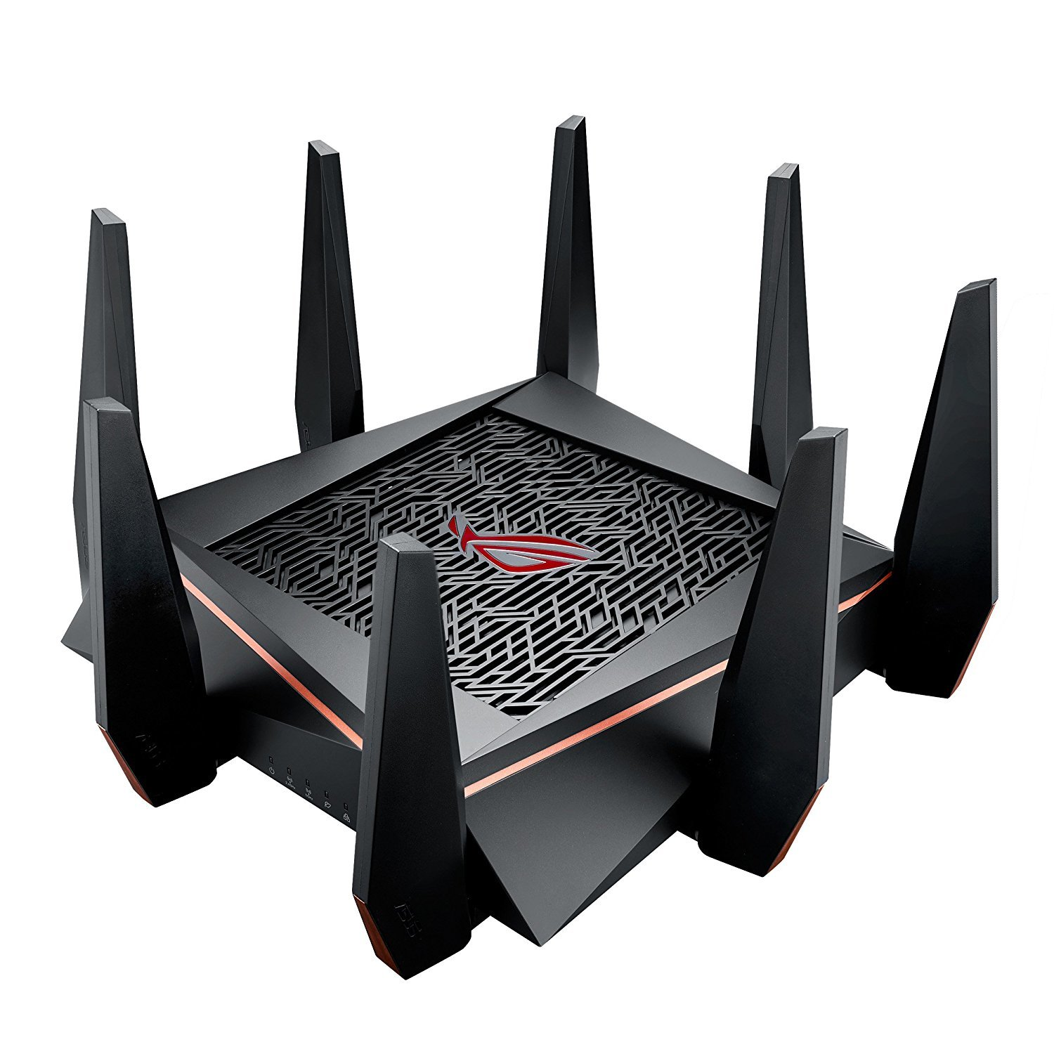
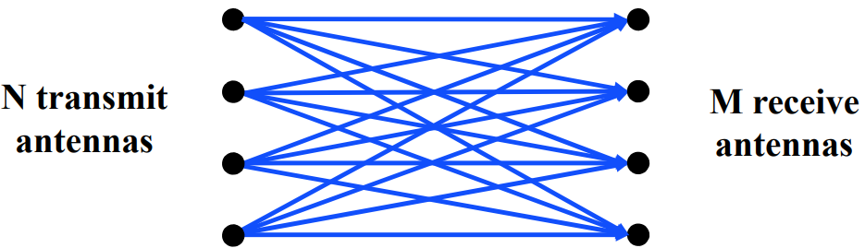
MIMO – Multiple In Multiple Out
N x M subchannels can be used to send data simultaneously
Huge boost in data throughput
Antenna diversity adds to reliability as well
The signals may interfere with each other
But receiving all of them allows the data to be recovered
Beamforming
Use interactions between array of antennas to focus energy on the receiver

Slide 42
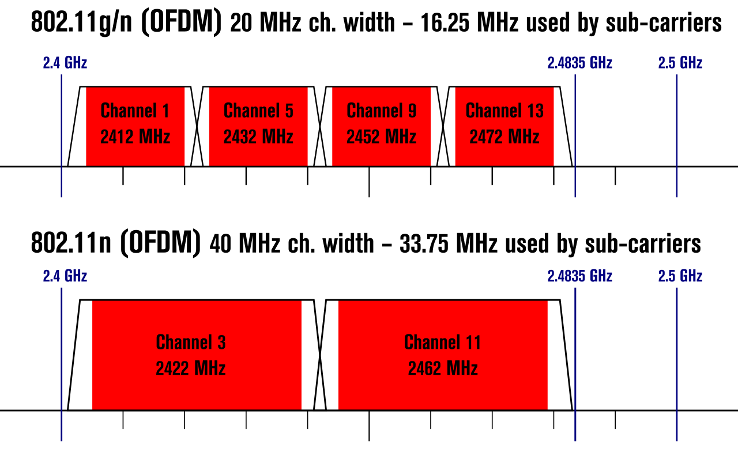
Expandable bandwidth
OFDM allows many subcarriers within a channel to be used at once
Throughput scales with the amount of bandwidth available
Allow larger 40 MHz channels to be used

Slide 43
802.11n (2009)
Supports OFDM and MIMO on 2.4 GHz and 5 GHz
Supports 20 MHz and 40 MHz channels
Easier to create large channels in 5 GHz band
Backwards compatible with 802.11g (tries not to be with 802.11b)
Wildly successful
Still the 2.4 GHz band protocol (802.11ac is 5 GHz only)
A little less than half of the networks visible to me are still 802.11n

Slide 44
Major amendments
 | Protocol | Year | Frequency | PHY | Max Rate | Range
- | 802.11 | 1997 | 2.4 GHz | DSSS/FHSS | 2 Mbps | 20 m
1 | 802.11b | 1999 | 2.4 GHz | DSSS | 11 Mbps | 35 m
2 | 802.11a | 1999 | 5 GHz | OFDM | 54 Mbps | 35 m
3 | 802.11g | 2003 | 2.4 GHz | OFDM | 54 Mbps | 38 m
4 | 802.11n | 2009 | 2.4/5 GHz | OFDM + MIMO | 600 Mbps | 70 m
5 | 802.11ac | 2013 | 5 GHz | OFDM + MU-MIMO (downlink only) | 3.4 Gbps | 35 m
6 | 802.11ax | 2021 | 2.4/5/6 GHz | OFDMA + MU-MIMO | 9.6 Gbps | 35 m
802.11b was very popular but is now usually unsupported
802.11a never saw major deployment

Slide 45
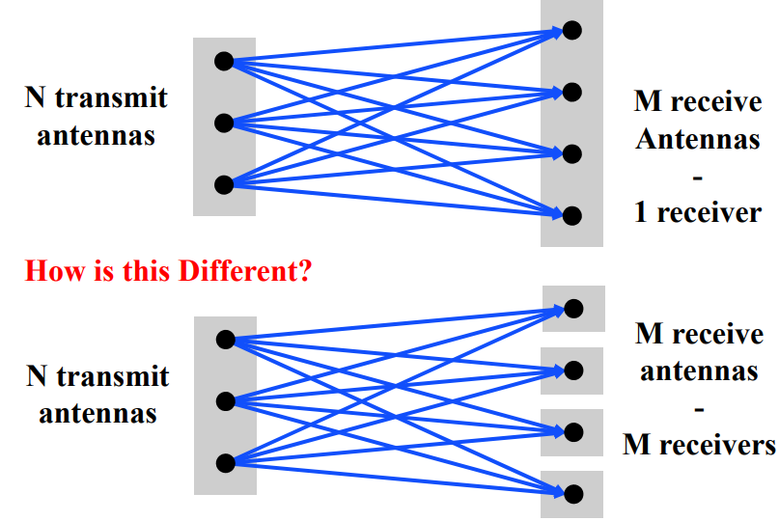
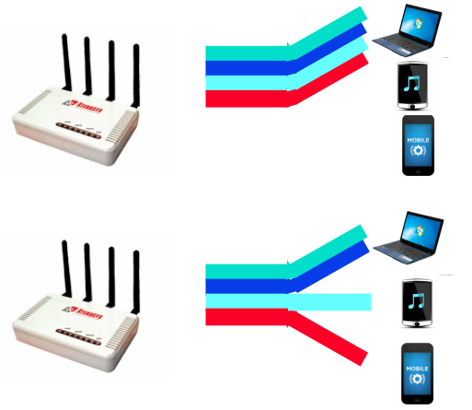
Multi-user Multiple In Multiple Out (MU-MIMO)
Multi-user MIMO uses the same techniques to send in parallel to multiple devices
Devices cannot cancel out interference anymore
Send slower, more reliable data streams to overcome this

Slide 46
802.11ac (2013)
Update for 5 GHz band only
Supports Downlink MU-MIMO (from AP to device)
Supports channels widths up to 160 MHz
Engineering updates: up to 256-QAM
Routers apply 802.11ac to 5 GHz and 802.11n to 2.4 GHz

Slide 47
802.11ac channels

Slide 48
Major amendments
 | Protocol | Year | Frequency | PHY | Max Rate | Range
- | 802.11 | 1997 | 2.4 GHz | DSSS/FHSS | 2 Mbps | 20 m
1 | 802.11b | 1999 | 2.4 GHz | DSSS | 11 Mbps | 35 m
2 | 802.11a | 1999 | 5 GHz | OFDM | 54 Mbps | 35 m
3 | 802.11g | 2003 | 2.4 GHz | OFDM | 54 Mbps | 38 m
4 | 802.11n | 2009 | 2.4/5 GHz | OFDM + MIMO | 600 Mbps | 70 m
5 | 802.11ac | 2013 | 5 GHz | OFDM + MU-MIMO (downlink only) | 3.4 Gbps | 35 m
6 | 802.11ax | 2021 | 2.4/5/6 GHz | OFDMA + MU-MIMO | 9.6 Gbps | 35 m
802.11b was very popular but is now usually unsupported
802.11a never saw major deployment

Slide 49
New directions in WiFi focus: Aggregate throughput across all devices
For point-to-point, WiFi is “(more than) fast enough”
Now the problem is the quantity of devices in a single space
Desktop, laptop, tablet, smartphone, smartwatch, IoT devices, etc.
Insight: Bring established cellular techniques to WiFi

Slide 50
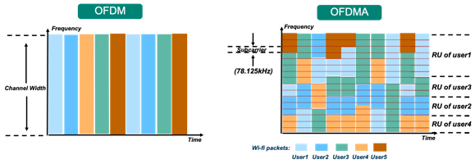
Orthogonal Frequency Division Multiple Access
OFDM: split channel into subcarriers and transmit on those
OFDMA: allocate subcarriers to a device for an amount of time
Turns OFDM into an access control mechanism
Complicated question: which device gets which subcarriers at which time?

Slide 51
802.11ax (2021)
Standard approved on February 9th 2021
First devices started supporting it in 2019 (WiFi 6)
6 GHz band (WiFi 6E)
1.2 GHz of bandwidth (5.925-7.125 GHz)
2020: US FCC made band available for unlicensed use!!!
EU is expected to follow in March 2021
OFDMA
MAC scheduling variant of OFDM
Schedule devices based on time and subcarrier allocations

Slide 52
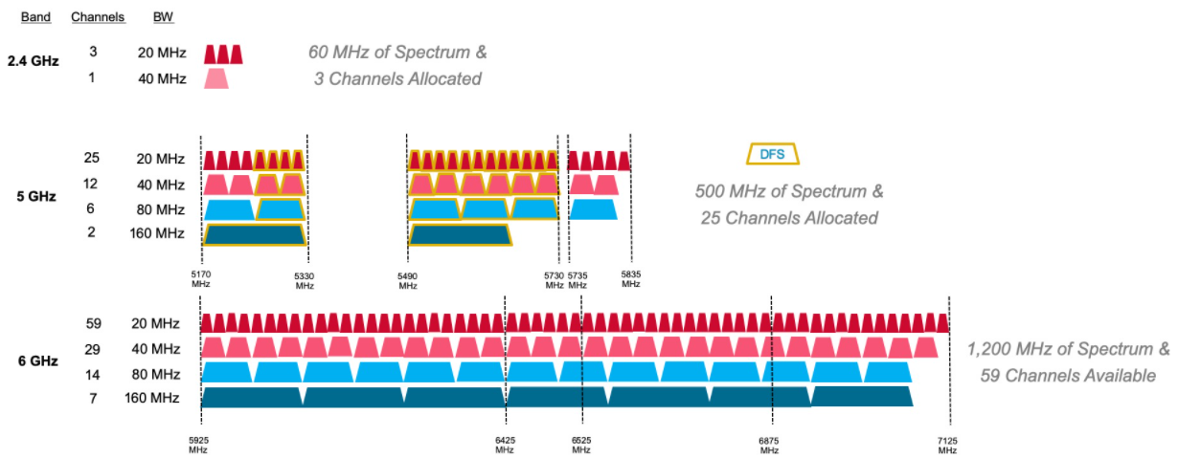
6 GHz band is an enormous amount of bandwidth

Slide 53
Roadmap of the lecture today
General course information and updates
Let us review what we had covered the last lecture
Wi-Fi
Cellular
Bluetooth

Slide 54
The first commercial mobile phone was in 1946!
By 1948, 5000 users placing around 30,000 calls weekly
“The equipment, of course employing vacuum tubes, weighed eighty pounds, filled much of a vehicle’s trunk and drew so much power that it would cause the headlights to dim. Service cost $15 per month, plus thirty to forty cents per local call, equivalent to $175 2012 dollars, plus $3.50 to $4.65 per call. “
https://ethw.org/The_Foundations_of_Mobile_and_Cellular_Telephony
https://www.smithsonianmag.com/innovation/first-mobile-phone-call-was-made-75-years-ago-180978003/

Slide 55
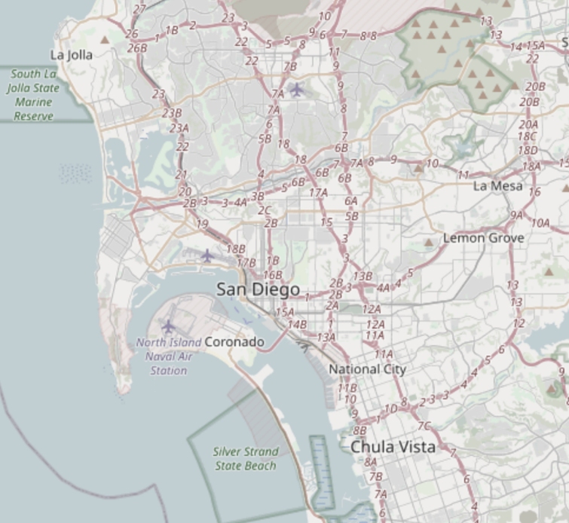
The first `mobile` network architecture
Single transmitter tower, multiple receiver towers
Medium Access Control?
Push-to-talk [half-duplex]
City-wide “party line”
Maximum of three concurrent callers
Notes:
A single transmitter on a central tower provided a handful of channels for an entire metropolitan area. Between one and eight receiver towers handled the call return signals. At most, three subscribers could make calls at one time in any city using the single transmitter and the tiny amount of spectrum allocated by the Federal Communications Commission to this service. It was in effect a massive party line, where a tightly controlled number of subscribers had to listen first for someone else on the line, and, if finding the line free, signal an operator, who would place the call. During the call, the user depressed a button on the handset to talk and released it to listen.

Slide 56
1965: The Improved Mobile Telephone Service
”More spectrum”
Bell: VHF Low (35-44 MHz, 9 channels), VHF High (152-158 MHz, 11 channels), UHF (454-460 MHz, 12 channels)
7 channels at VHF, and 12 channels at UHF for "RCCs" (Radio Common Carriers)
These will end up becoming pagers, mostly
“Full Duplex”
Implemented as channel pairs (two half-duplex)
Spectrum alone is not enough
Limited to 40,000 total subscribers
NYC had 2,000 people on 12 channels with a typical wait of 30 minutes to place a call
Phones fit in a briefcase now
Notes:
Also now full duplex, and no more operators

Slide 57
What’s inefficient with this picture?
Early mobile networks handled the mobility challenge with wide-area coverage
The active user could be anywhere in the 40~60 mile range of the transmit tower
So they had exclusive access to that whole area!
12 frequency channels → 12 users

Slide 58
The `cell` in cellular networks
Cell is spatial division
Reduce transmit power, smaller area
Now…
12 / 3 = 4 channels per cell
* 6 cells in area
= 24 users of same spectrum!
And we can choose the cell size based on our expected needs

Slide 59
Spatial division tradeoffs
?
Need more infrastructure (more towers)
Need logic to support handoff

Slide 60
GSM
Modern 2G “GSM”?
“Global System for Mobile Communications”
It is a standard [the dominant 2G]
GSM meant “phone” for a while in parts of Europe
GSMA is the GSM Association; which a lot of people just call GSM
Because GSM made [a] 3G and LTE [which is a 4g?] and 5g [ish! more next time]

Slide 61
GSM Short Message Service
Short Message Service (SMS) provides a connectionless transfer of messages with low capacity and long latency performance
Each short message can contain up to 140 octets (or 160 7- bit characters)‏
Messages are transported on the GSM SDCCH signaling channels
Two types of SMS have been defined:
Cell broadcast service
Point-to-point service
Notes:
61

Slide 62
GSM evolved over time to add data
GSM was voice-only at first
Then overlaid data on the voice channel
Circuit Switched Data (CSD)
9.6 — 14.4 kb/s
Previous hacks were literally cell phone calling a modem (~3.5 kb/s); same concept
Then added actual packetized data [“2.5G”]
General Packet Radio Service (GPRS)
Throughput 9.2 – 21.55 kbit/s/timeslot [goodput 8-20 kbit/s/timeslot]
Enhanced Data Rates for GSM Evolution (EDGE)

Slide 63
Moving to 3G Systems
Provides high-speed wireless communication for multimedia
Voice: quality comparable to PSTN
Data: 144kpbs for high-speed user (driving), 384kpbs for slowly moving user (walking) and 2.048Mbps for stationary user
2.5G Systems
GPRS/EDGE (GSM)‏
Notes:
63

Slide 64
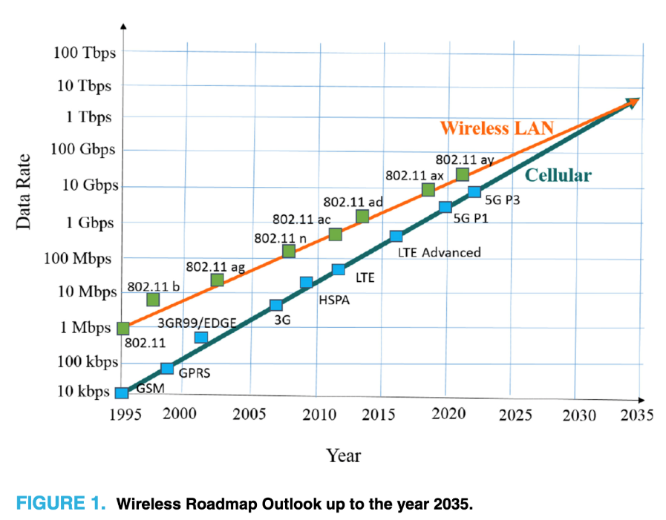
So what did [*]G provide?
Biggest thing is throughput
Terahertz Band: The Last Piece of RF Spectrum Puzzle for Communication Systems (preprint; Elayan et al.)

Slide 65
3G Systems and beyond
CDMA-based 3G systems more widely accepted
CDMA 2000 in US
UMTS in Europe
3.5G Systems
HSPA
Moving from circuit-based to packet-based
Fourth Generation – ITU specifications:
target peak data rates of up to 100 Mbit/s for high mobility, 1 Gbit/s for low mobility
Notes:
65

Slide 66
Development of 4G, 5G and beyond: 3GPP Project
3rd Generation Partnership Project (3GPP)
Industry alliance for development of telecoms standards
Established around 1998
Makes “Releases” which are roughly analogous to IEEE standards/versions
Release 8 (2008) LTE ~4G
Release 15 (2018) NR (New Radio) ~5G
Focused on the practical
ITU post-hoc defined “4G”, 3GPP defined LTE and LTE_________

Slide 67
Different LTE Releases
Release 8 (2008)
Peak Rate: downlink 300 Mb/s, uplink 75 Mb/s
a one-way radio-network delay of less than 5ms
Release 9 (2009)
Support for broadcast/multicast services, positioning services, and enhanced emergency-call functionality
Release 10 and beyond – LTE Advanced

Slide 68
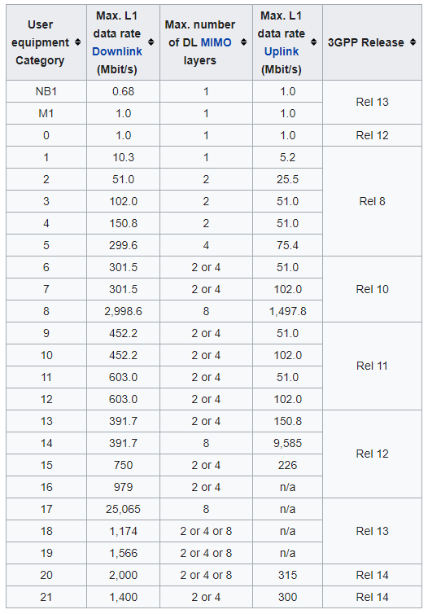
LTE Categories
Different equipment supports different “categories” of LTE
Maximum MCS index supported
Examples
iPhone 6 (2015): Cat 4
Pixel 3 (2018): Cat 16
Notes:
MCS = Modulation Coding Scheme
https://mcsindex.com/ looks like all the tables for WiFi; not clear whether this is the same for cell

Slide 69
So what is 5G doing differently?
Largely, 5G is a small(er)-cell technology
“Urban optimized”
This does also allow for higher performance

Slide 70
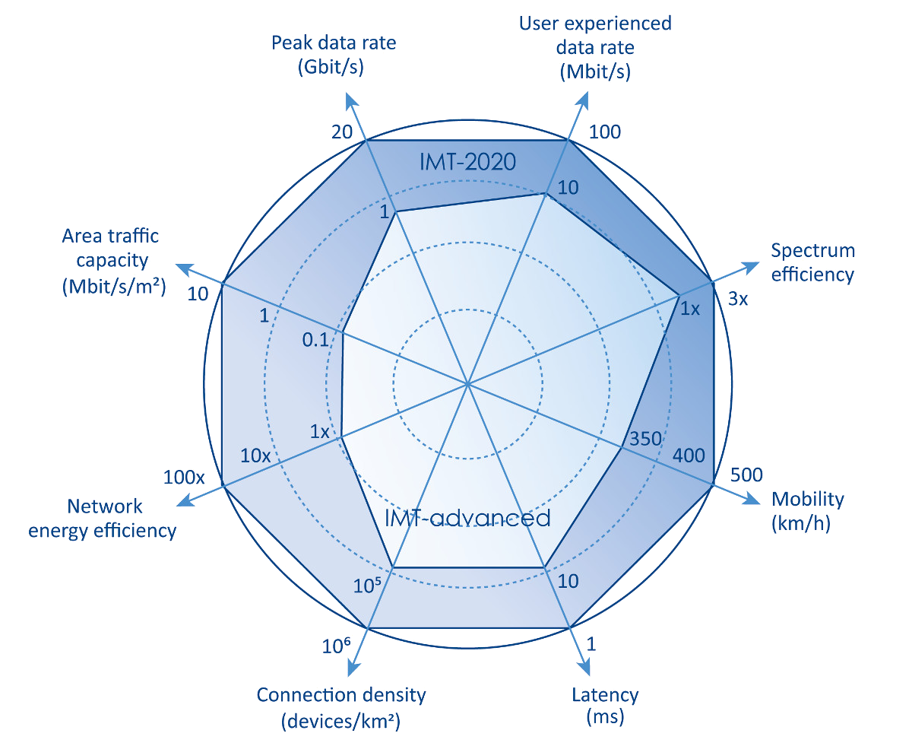
5G
https://www.etsi.org/technologies/5g

Slide 71
Additional low-end categories for IoT
LTE Cat 0
Traditional LTE, but focused on the really low end
LTE-M (LTE Cat M1)
375 kbps uplink, 300 kbps downlink (for the actually implemented mode)
Reduced power and maximum bandwidth
Increased range
NB-IoT (LTE Cat NB1)
65 kbps uplink, 26 kbps downlink
Reduced power and greatly reduced bandwidth
Greatly increased range

Slide 72
Why do we need “special categories” for IoT on cell?
Pragmatic for the end device
Lower power
Allow for long-off periods
Pragmatic for network operators
Allows for scale– network no longer needs to assume that devices could always be on in each cell

Slide 73
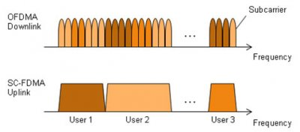
LTE-M and NB-IoT downlink and uplink
OFDMA downlink
Put the more complicated hardware in the cell tower [simple FFT demodulator]
SC-FDMA (single carrier FDMA) uplink
Blocks of subchannels combined into one signal
Similar concept, but simpler for end devices to implement

Slide 74
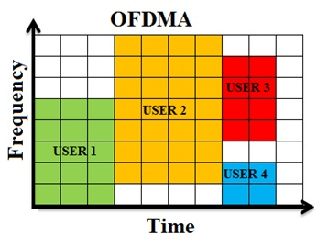
LTE resource allocation
Cellular uses OFDMA to schedule
Time + Frequency -> “2D Scheduling”
Cellular uses single channels up to 20 MHz
Further divides these into 100 Resource Blocks
Resource Block
12 subcarriers for OFDM in frequency (15 kHz each)
7 symbols in time (0.5 ms)
Devices are allocated frequency and time based on what they are sending
Allocated in units of Resource Blocks
One “Resource Block”

Slide 75
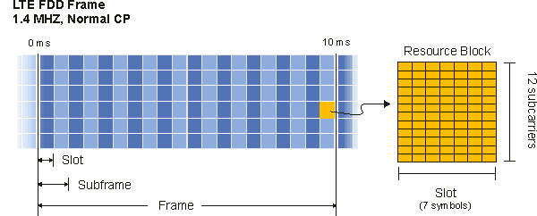
Resources used by LTE-M and NB-IoT
LTE-M uses up to 6 resource blocks
1.4 MHz of bandwidth (1.080 MHz)
Can co-exist with other normal LTE traffic, scheduled by cell tower
Limited to only some capability of LTE (much less throughput)

Slide 76
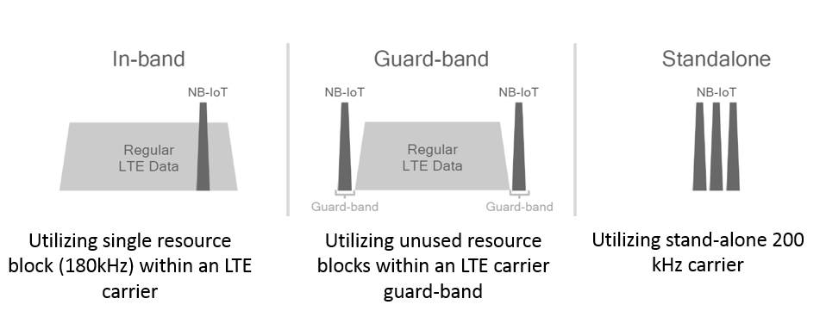
Resources used by LTE-M and NB-IoT
NB-IoT uses up to 1 resource block
200 kHz of bandwidth (180 kHz)
Multiple deployment options
Guard-band in practice

Slide 77
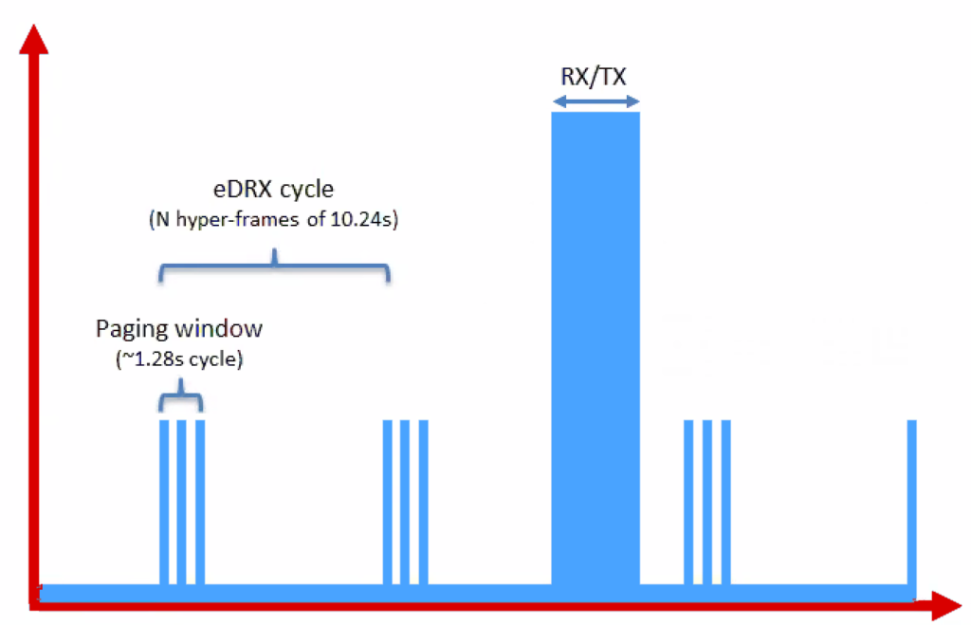
Reducing power for IoT devices
Reduce max Tx power to 20 dBm
Increased receive sensitivity at tower will cover it
Extended Discontinuous Reception (eDRX)
Allow devices to reduce paging period and still stay on network
Cell tower will hold messages
What does this get to?
“For a LTE-M1 device that transmits data once per day, and wakes up every 60 hyper frames to check for commands (this would be about every 10 minutes), a life of 4.7 years is achievable on 2 AA batteries.”
Graphics, quote from https://www.link-labs.com/blog/lte-e-drx-psm-explained-for-lte-m1

Slide 78
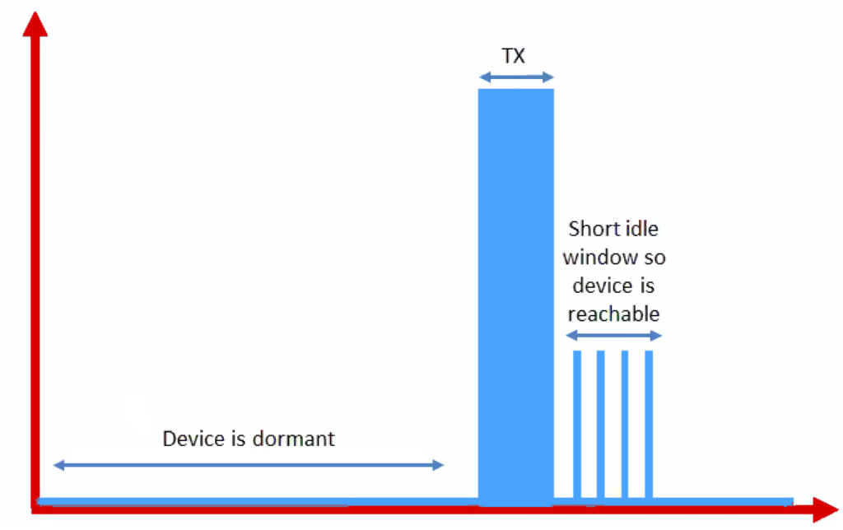
Further power reduction for simple devices
Power Saving Mode (PSM)
For very simple, uplink-focused devices, allow them to turn off entirely but stay connected
Minutes to days in duration
Notify tower before sleeping, listen for packets after each transmission
Graphics from https://www.link-labs.com/blog/lte-e-drx-psm-explained-for-lte-m1

Slide 79
Improved range for LTE-M and NB-IoT
LTE defines a Maximum Coupling Loss (MCL) a.k.a Link Budget
Traditional cellular: 144 dB (~2.5 km)
LTE-M: 160 dB (~5 km)
NB-IoT: 164 dB (~10 km)
Sigfox: ~155 dB
LoRaWAN: ~143 dB
Note that many cellular bands are often on higher frequencies
Example: 1900 GHz

Slide 80
Roadmap of the lecture today
General course information and updates
Let us review what we had covered the last lecture
Wi-Fi
Cellular
Bluetooth

Slide 81
Basics of Bluetooth Low Energy (BLE)
Direct device-to-device communication
Usually: Computer to Thing
Smartphone to device, Laptop to device, etc.
Focus on making the “Thing” really low energy
Push energy-intensive requirements onto “Computer”

Slide 82
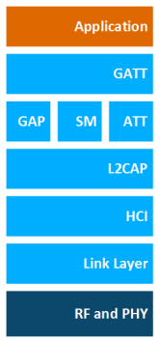
BLE Layers
GAP
Host – Configuration and Server
GAP – Generic Access Profile
Configure advertising
GATT – Generic Attribute profile
Configure connections
HCI - Host Controller Interface
Controller - Communication
Link Layer – send packets
RF and PHY – send bits
Host
Controller

Slide 83
Two different communication modes in BLE
Advertising
Discovery
Advertisements – broadcast messages indicating device details
Ephemeral, uni-directional communication from Advertiser to Scanner(s)
ALOHA access control
Connections
Interaction
Bi-directional communication between Peripheral and Central
Maintained for some duration
TDMA access control

Slide 84
BLE network topology
Peripheral
Connection
Central & Scanner
Scanner
Connection
Peripheral
Advertisement
Advertisement
Advertisement
Advertisement
Advertiser
Advertiser
Advertiser

Slide 85
Bluetooth devices multiple roles at the same time
Topology picture is a simplification of roles
A single device can have multiple roles simultaneously
Scanning and Advertising simultaneously
Peripheral and Scanner and Advertiser simultaneously
Peripheral and Scanner and Central and Advertiser simultaneously
Also possible:
One Peripheral can be connected to multiple Central

Slide 86
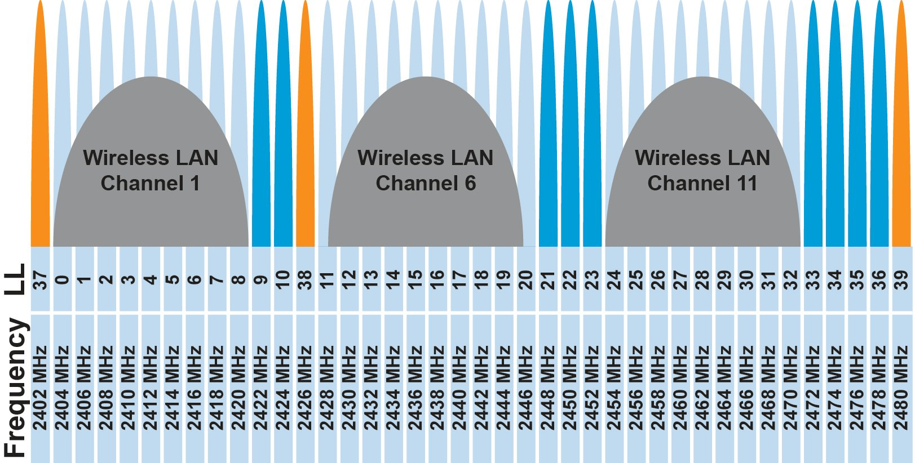
BLE frequency
2.4 GHz carrier, Forty 2-MHz channels, 1 Mbps data rate
37, 38, 39 for advertising
0-36 for connection (FHSS)

Slide 87
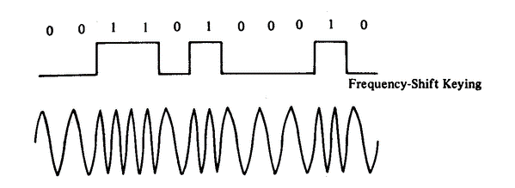
BLE modulation
Gaussian Frequency-Shift Keying (GFSK)
Improvement on base Frequency-shift Keying
Smoother transitions between bits -> reduces nearby interference

Slide 88
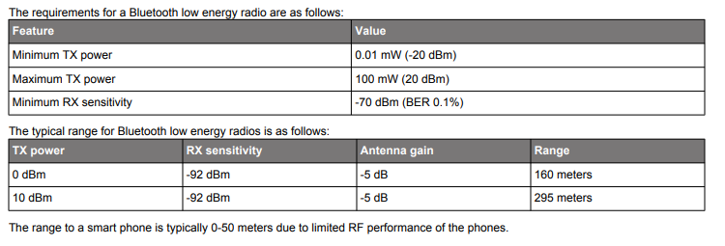
BLE signal strength
What are capabilities of CC2650?

Slide 89
Advertising
BLE discovery mechanism
Make nearby devices aware of advertiser’s existence
Communicate some information from or about advertiser
Traditional purpose is to enable connections, but this is also useful for general communication
Advertisements
Periodic broadcast messages with data
Scan Requests/Responses
Scanner sends responses after getting a request
Only occurs when scanner is listening

Slide 90
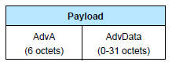
Advertisement payloads
AdvA – address of the advertiser
TxAdd bit from header specifies if this is a “public” or “random” address
Remaining up to 31 bytes are available for use
Putting it all together, up to 47 bytes total:
BLE Packet
Advertising PDU
Preamble 1 Byte | Access Address 4 Bytes | Header 2 Bytes | Advertiser Address 6 Bytes | Advertiser Data (Payload) 0-31 Bytes | CRC 3 Bytes

Slide 91
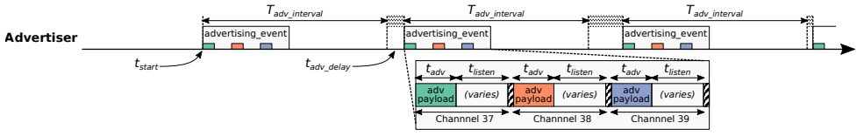
Advertising timing
Advertising Events occur periodically [20ms – 10.24 s] (or longer)
Plus a random delay after each instance [0-10ms]
Why?
User picks the rate as a tradeoff of energy and discovery latency

Slide 92
Advertising timing
Advertising Events occur periodically [20ms – 10.24 s] (or longer)
Plus a random delay after each instance [0-10ms]
Why? Collisions
User picks the rate as a tradeoff of energy and discovery latency

Slide 93
Advertising event
Three transmissions, one on each advertising channel
Always in the same order
Transmission, followed by listening window on that same channel
Requests will be sent >=150 us (Inter-Frame Spacing, IFS) after Tx
Followed by a retune to the next channel frequency
Short listen window to enable low-power operations

Slide 94
Preserving energy in communication
Most energy is spent listening
This is due primarily to how long listening durations are compared to transmissions
Example: maximum-sized BLE transmission:
8 bits/byte * 47 bytes = 376 bits at 1 Mbps = 0.376 ms transmitting
So listening for an entire second is >2500 times longer
But listening for only 0.376 ms requires sub-ms synchronization, which itself costs energy to manage…
Instead, when advertising, nRF radios listen for ~0.200 ms, only after a transmission

Slide 95
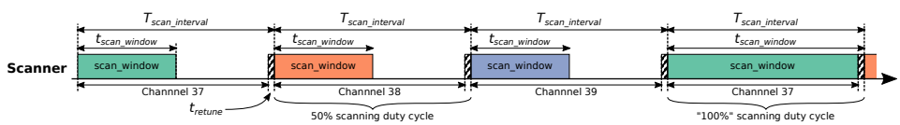
Scanning Pattern
Iterate through channels, listening for advertisements
T_{scan_interval} controls rate at which channels are changes
T_{scan_window} controls duty cycle of listening
Why listen at a low duty cycle?

Slide 96
Scanning Pattern
Iterate through channels, listening for advertisements
T_{scan_interval} controls rate at which channels are changes
T_{scan_window} controls duty cycle of listening
Why listen at a low duty cycle? Save energy

Slide 97
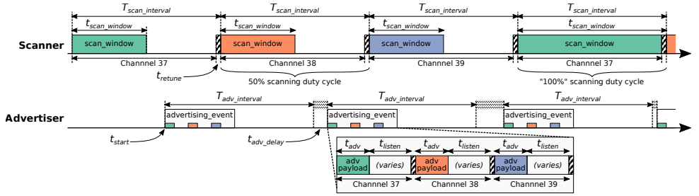
Putting it all together
Advertisements are received when the channel of the scan window and the channel of the advertisement overlap in time (and space)

Slide 98
Scanning expectations
Scanners will NOT receive 100% of packets sent
Packets are lost due to one or more of following:
Duty cycle
Sharing 2.4 GHz antenna with WiFi
Retune period after each scanning interval
Dropped packets in the receive software
Packet collisions

Slide 99
Payload of an advertisement
BLE payload?
Theoretically whatever you want, but that isn’t very compatible
Point is to specify capabilities of the advertiser
Desire: specify payloads in such a way that all scanners can interpret what they mean about the device
This is different from traditional internet packets
Broadcasts are for _anyone_ to hear, not a specific server/application

Slide 100
Advertisements are already being used for communication
BLE advertisements are uncoordinated, broadcast messages designed for discovery.
Devices are being deployed using advertisements.
Beacons – iBeacon
Tracking – Tile
Local communication – Apple Continuity
Notes:
PowerBlade is a great example of this.
It’s a plug-load power meter
Initially configured to use advertisements as a simple method for reading measurements with a smartphone
We are interested in household deployments where dozens of PowerBlades will be deployed to measure all the loads in a home
Can we still use BLE advertisements for data transfer in the presence of many other devices?

Slide 101
Beacons
Advertising with advertisements!
Web of Things
Real-world tags that broadcast virtual-world identifiers
iBeacon and Eddystone
Formats for sending URLs and device identifiers
Use existing BLE fields (Service Data and Manufacturer-Specific Data)

Slide 102
Tracking
Find devices nearby
Get a sense of distance to the device
Find my X
Tile: find my keys
Apple: find my device
Uses TX power level field
Lists the transmitted power of the device
Pathloss = TX power – RSSI (all in dBm)

Slide 103
Overview of connections
Connections are for bi-directional communication with higher throughput than advertisements
Simple view
A peripheral is either advertising or in a connection
A central is scanning and in one or more connections
(Remember: devices can have many roles simultaneously)
While in a connection both devices act like servers
Either device can read/write fields available on the other device

Slide 104
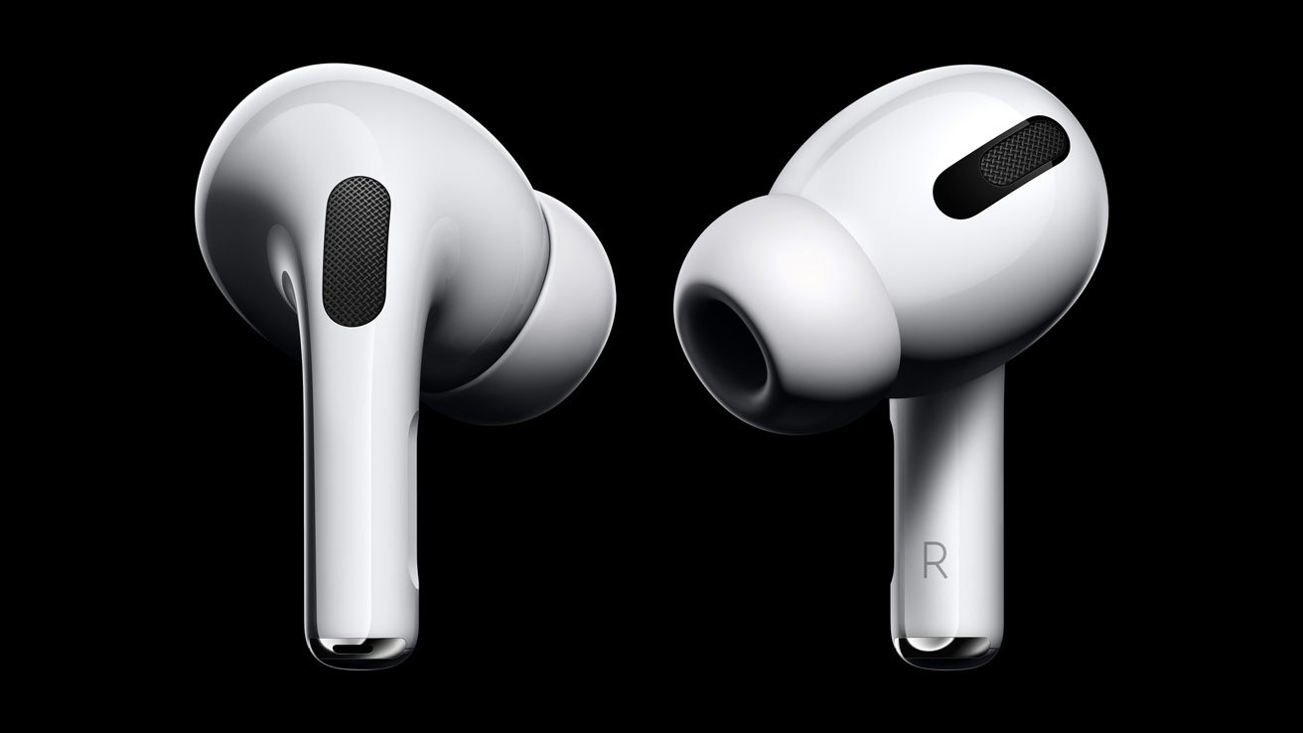
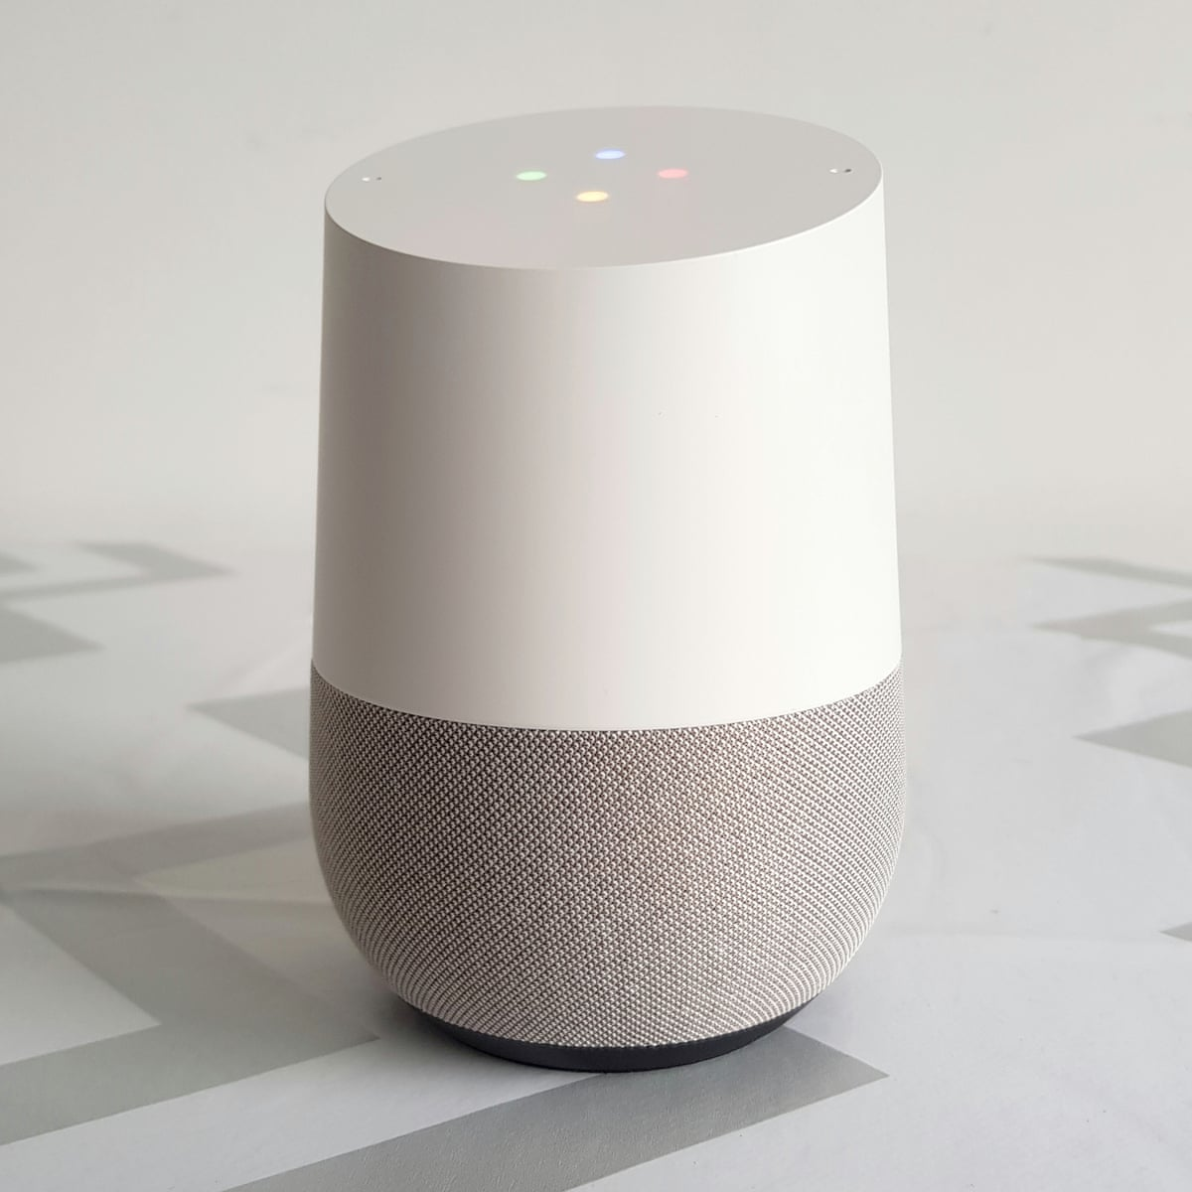
Applications utilizing Bluetooth in connection made

Slide 105
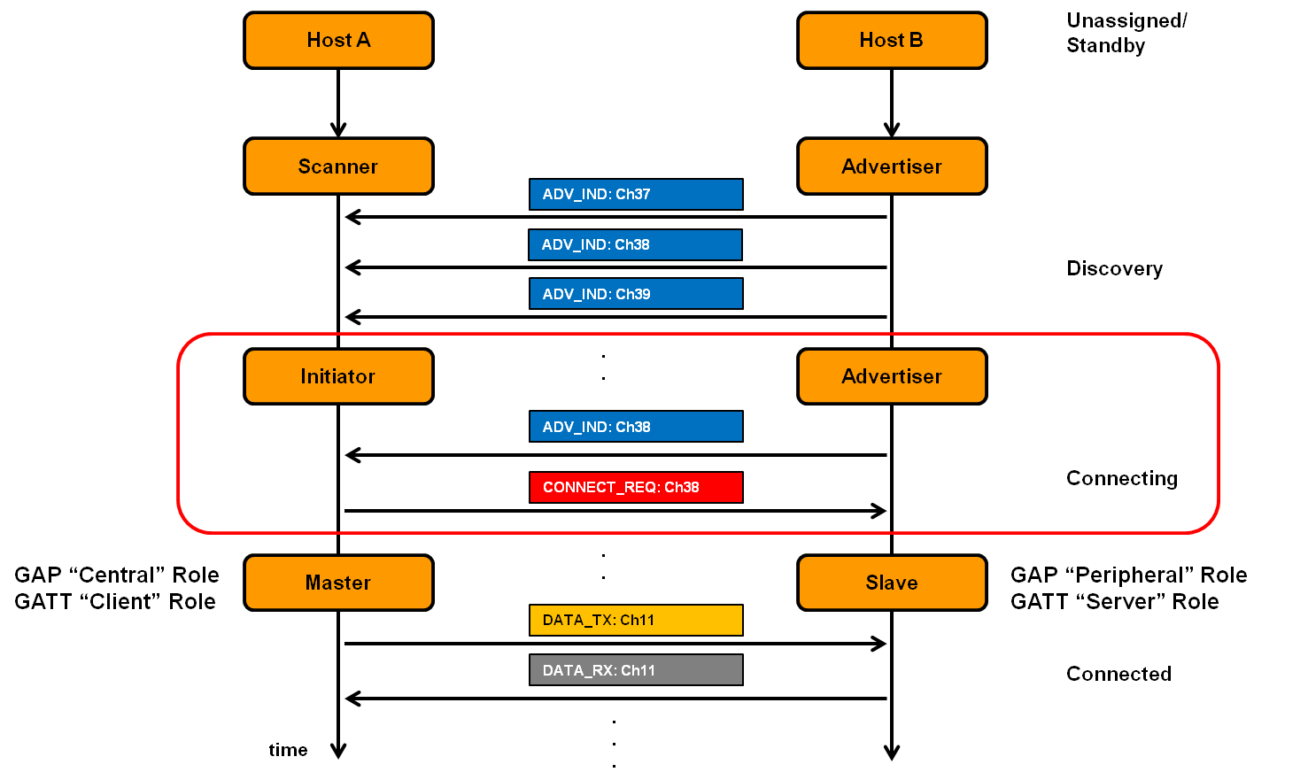
Connection timeline (in picture form)
Central
Peripheral

Slide 106
Connection timeline
Initiating a connection
Peripheral is sending broadcast advertisements
Central is scanning and receives an advertisement
Central sends connection request
During a connection
Central sends a packet each “connection interval”
Peripheral immediately responds with a packet
Multiple packets may be exchanged this way until done
Repeat at next connection interval
Ending a connection
Either device sends termination packet
Timeout occurs on either device

Slide 107
Questions about Bluetooth “network”
How does TDMA MAC for connections work?
Implies a schedule
Implies synchronization
How many devices can be in a network?
How much throughput can a device have?

Slide 108
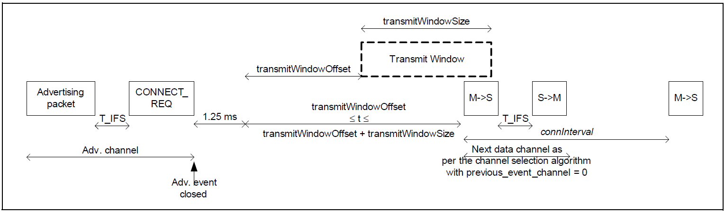
How is the TDMA schedule created/managed?
Only the central needs to know the schedule
It controls interactions with the peripheral(s) it is connected to
Anchor point, connection interval determines schedule for devices
Central to Peripheral
Peripheral to Central
Central to Peripheral

Slide 109
How is synchronization managed?
Central sends first packet at each connection interval
So peripheral must be synchronized to central
Resynchronization can occur on each received packet
Specification describes how a peripheral must widen its listening window based on “Source Clock Accuracy”

Slide 110
How many devices can be connected?
We can schedule with granularity of at least 1.25 ms (offset steps)
That’s at least 800 devices per second
Intervals go up to 4 seconds, so multiply by four
That’s 3200 devices per max interval
Plus central can skip intervals on occasion without dropping the connection
And really the offset defines a window. More granularity is available
Answer: thousands of devices
Although each is sending minimum-sized packets each interval

Slide 111
How many devices can be connected in the real world?
The limit is much much lower on real devices
Example: Android sets a limit at around 4-15
nRF52 s140 softdevice allows up to 20
Connection management is often done in firmware
Softdevice for nRF, firmware on the radio chip in smartphones
Limited by memory and complexity

Slide 112
Roadmap of the lecture today
General course information and updates
Let us review what we had covered the last lecture
Wi-Fi
Cellular
Bluetooth

Slide 113
Wireless Networking
Ambuj Varshney
ambujv@nus.edu.sg
Notes:
++ Thank you for inviting me to give this talk
++ In this talk, I will present a pathway that can enable us to make wireless embedded systems ubiquitous. I will describe my previous research efforts that tackle the critical challenges that limit the growth of wireless embedded systems. These are related to the growing energy asymmetry that exists between sensing, computation and communication blocks on these platforms.
++ Finally, I will conclude my talk by covering the research agenda that I would like to work on as a faculty member.

